Slide 1
Browse Stack Demo
Under Guidance of Mrs. Vaishali Mam.
BY YELISETTI JAYANTH SRIHARI

Slide 2
Introduction :
BStackDemo is a sample e-commerce website by Browser Stack. It allows users to browse products, add them to a cart, and simulate purchases. Mainly used for testing purposes across different browsers and devices.

Slide 3
Responsibilities
WE HAVE TO WRITE TEST PLAN FIRST
WE HAVE TO WRITE TEST CASES
AUTOMATE TEST CASES
EXECUTE ALL THE TEST CASES.
CREATE DEFECT REPORT.

Slide 4
Overview
What is Browser Stack Demo ?
Browser Stack Demo (BStackDemo) is a sample e-commerce web application provided by Browser Stack. It allows users to browse products, add them to a shopping cart, log in with predefined credentials, and simulate placing orders. The site is mainly used for practicing web testing, especially cross-browser and automation testing, without the need for setting up complex environments. It helps developers and testers verify application functionality, responsiveness, and compatibility across different browsers and devices using Browser Stack's testing tools.

Slide 5
Modules
Module 1 : Login page
To check the functionalities of login page such as username, password and login button.
Example: username: demouser
password: testingisfun99
login button
Module 2 : Search bar
The search bar on Bstackdemo is designed to help users quickly find items they’re looking for. By typing in keywords or product names, it shows relevant results and lets users refine them with filters.
Example: iPhone.

Slide 6
Module 3 : Add to cart
When a user likes a product, they can add it to the cart to keep it aside while continuing shopping.
Example: iPhone (add to cart)
Module 4 : Delete from cart
If the user changes their mind, they can remove the product from the cart with a single click.
Example: iPhone (delete from cart)
Module 5 : Checkout
If the user wants to place any order then he should add the product to cart and he can place the order by checkout function , by adding details of shipping address
Example: First name: ABC
Last name: xyz
Address: Street no-7, Miami
State/province: Florida
Postal code: 123456

Slide 7
Module 6: Offers
Offers module shows the offered products according to your location or city.
Module 7: Orders
Orders shows the products which you have ordered previously.
Example: iPhone.(I have ordered iPhone in previous steps)
Module 8: Favorites
This module shows the products which the user added to favourites
Example: iPhone(I have added it to favourites)
Module 9: Sign out
This module is used when the user wants to sign out after completion of his/ her shopping.

Slide 8
Defects
While running a testcase at certain point I have been observed that the search module is not working. As, its functionality is to search according to user input.
I have been observed that the offers module is not working. As, its functionality is to show offers, but it is not showing offers. It shows offers according to location, but it should show offers irrespective of location and at the time of entering shipping address it should show not deliverable like that

Slide 9
Defect 1
Ø Defect identifier | Def_search_001
Ø Defect summary | Expected result=When we search a product it should display the searched product only but Actual result=showing not searched products also
ØTest Id | TC‑008 , TC‑009 , TC‑010 , TC‑011
ØTest case name | TC_search_valid_product, TC_search_partial_input, TC_search_invalid_input, TC_search_empty_input
ØModule name | Search
Øreproducible | Enter names to search
Øseverity | Medium
Øpriority | Medium
ØRaised by | Yelisetti Jayanth Srihari(Tester name)
ØAssigned to | (TL name)
ØDate of assignment | 04-09-2025
Østatus | open
ØSnap shots
ØFixed by | Shiva Upadhyay(Developer name
ØDate of fixing=
ØApprovals=manager name | Nisha Mandat(Manager name)

Slide 10
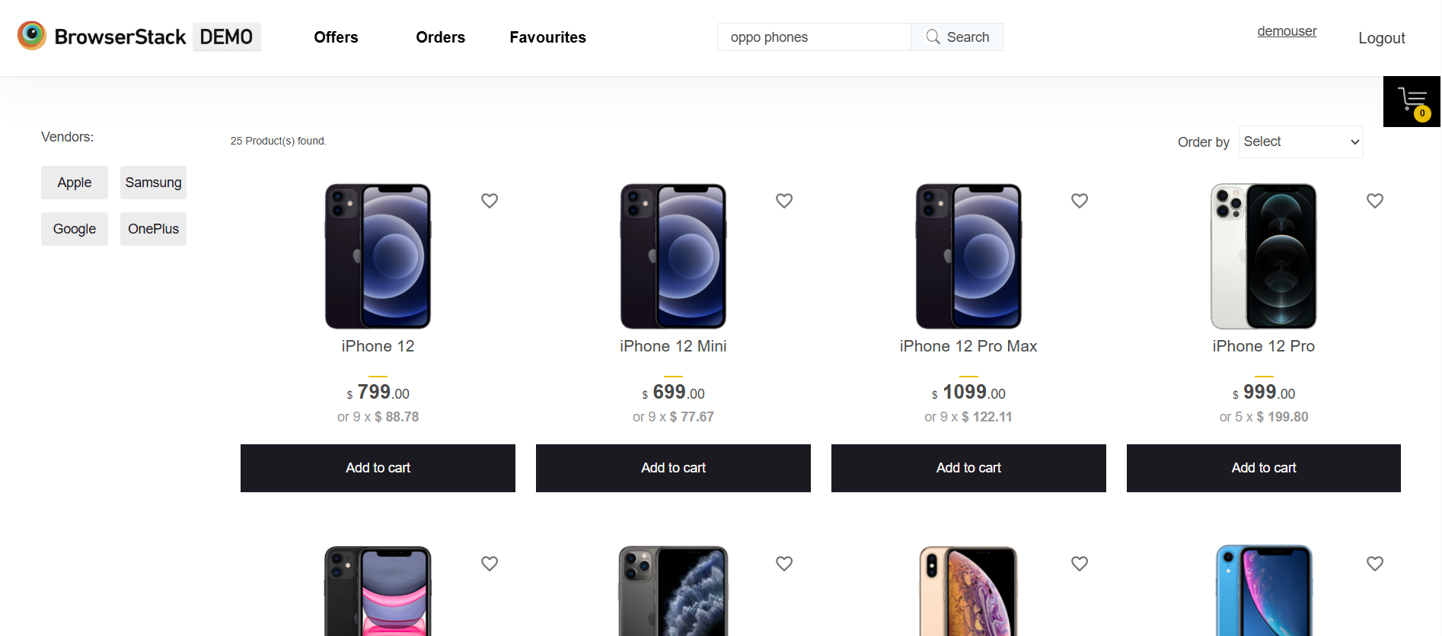

Slide 11
 | Defort Report-2
ØDefect identifier | Def_offers_001
ØDefect summary | Expected result=This module should shows offered products but Actual result=showing empty(No products)
ØTest Id | TC‑020 , TC‑021 , TC‑022 , TC‑023
ØTest case name | Tc_Offers_Page, Tc_Offer_Link_Navigation, Tc_Expired_offers, Tc_add_offers
ØModule name | Offers
Øreproducible | It should show offered products
Øseverity | Medium
Øpriority | Medium
ØRaised by | Yelisetti Jayanth Srihari(Tester name)
ØAssigned to | (TL name)
ØDate of assignment | 04-09-2025
Østatus | open
ØSnap shots
ØFixed by | Shiva Upadhyay(Developer name
ØDate of fixing=
ØApprovals=manager name | Nisha Mandat(Manager name)

Slide 12
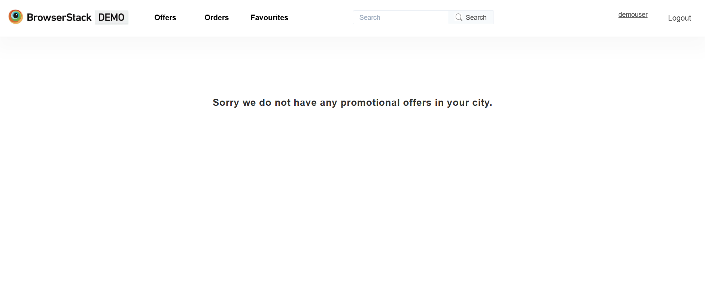

Slide 13
Challenges
While testing BStackDemo website which contains huge data I faced some challenges about:
There is comes difference in writing a test case and while running it.
As BStackDemo is a demo site designed for testing purposes, so there is a challenge in offers module that I can’t find any offers. It shows offers according to location, but it should show offers irrespective of location and at the time of entering shipping address it should show not deliverable like that.
While executing automation test cases , it is asking for verification for every time when we try to execute

Slide 14
Experience
With the help of this project I have learnt automation test cases.
Help to find out bugs.
Real time experience of Cucumber BDD framework
Manual testing needs strong observation and in that testers needs to apply all possibilities in test cases.

Slide 15
Thank You!!!
Vaishali Mam For Guiding Us through out the Project.

